Slide 1
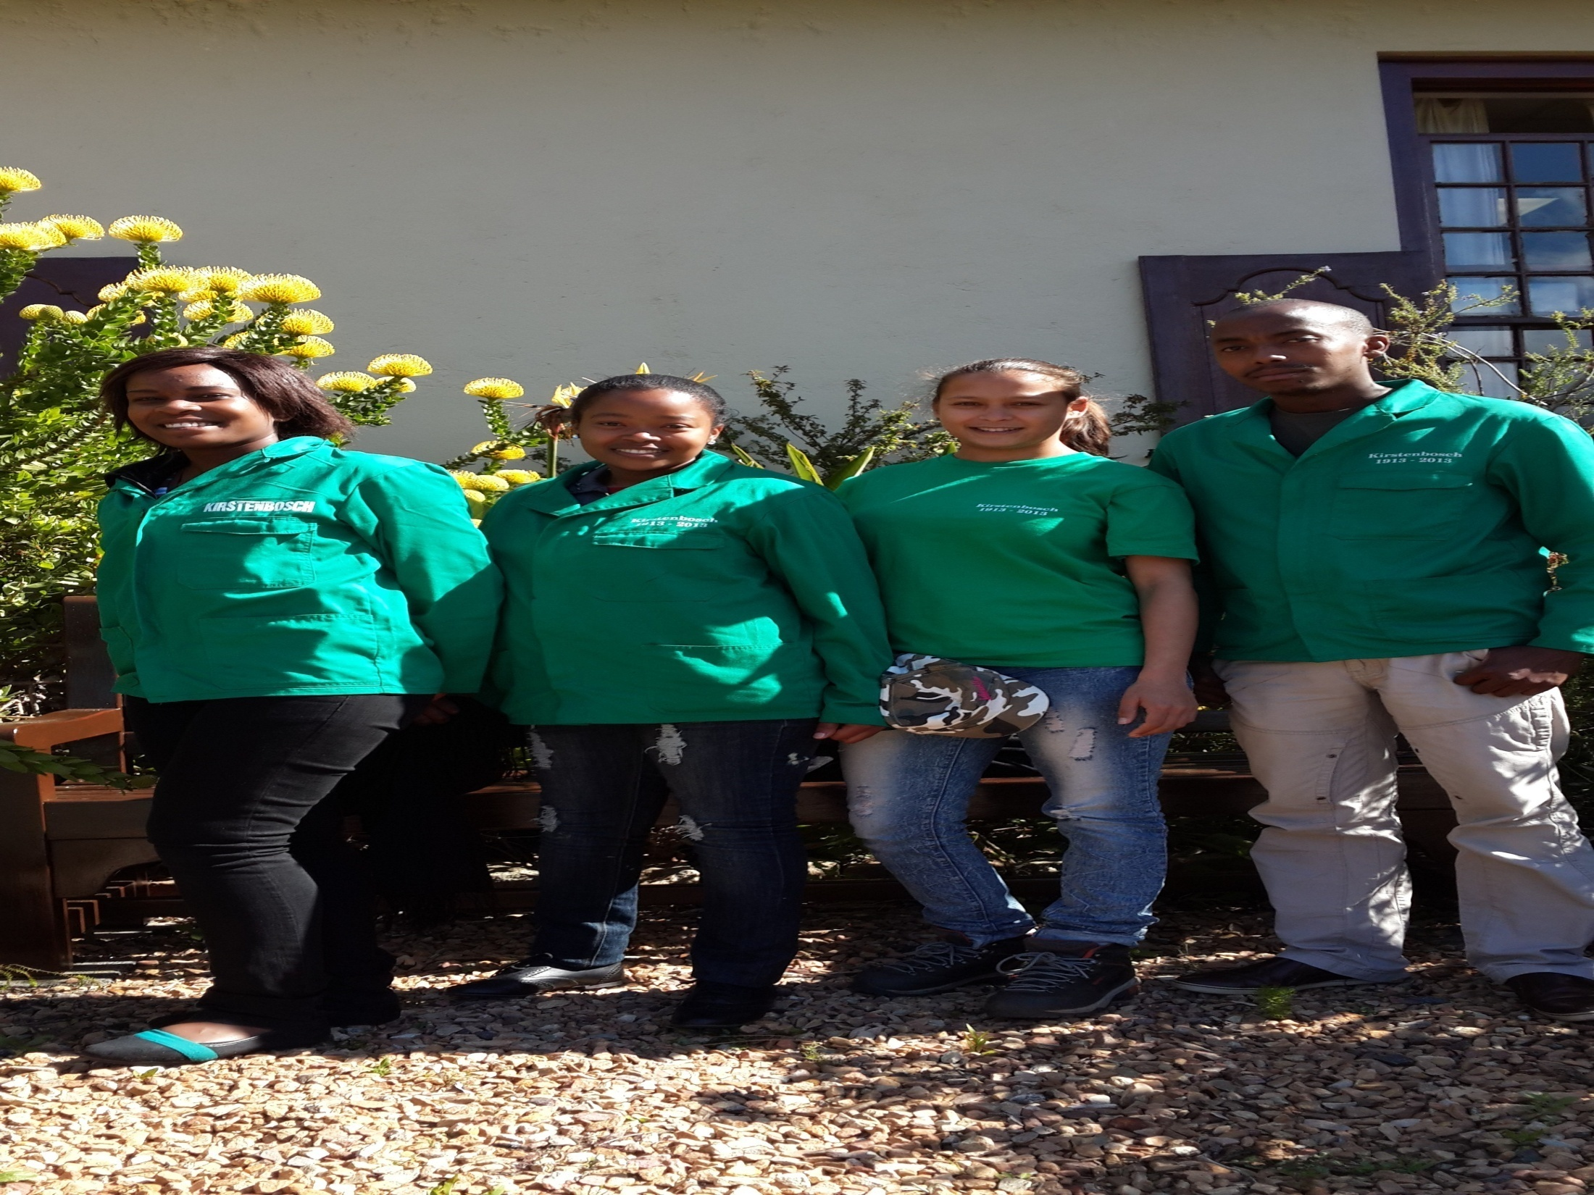

The Groen Sebenza Conservation team: What we do at Kirstenbosch
Supervisor: ELTON LE ROUX

Slide 2

Topics:
Why are we at Kirstenbosch?
Where to start from here?
Activities and Skills acquired
Future Plans
Challenges
Conclusion
Acknowledgements

Slide 3
Why are we here?
To learn, get experience etc.
Main Reason why we are at Kirstenbosch is to assist in the:
Protection
              Management
              Promote
              Sustainability
              Tackle or Educate
              And to contribute in SANBI`s vision, mission and value

Slide 4
Where to start from here?
Get used to the fact that you are now a professional worker
Familiarize yourself with your working environment
Ask questions
Plan, organize and implement

Slide 5
Activities and Skills Acquired
Resource Management
Conservation Communication
General Administration and Business Management
Conservation Compliance
Research Studies

Slide 6
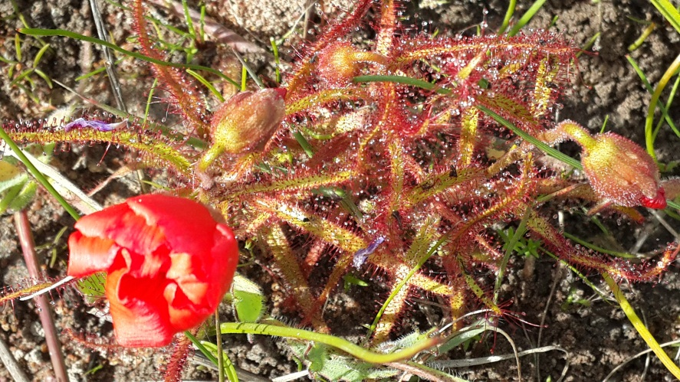
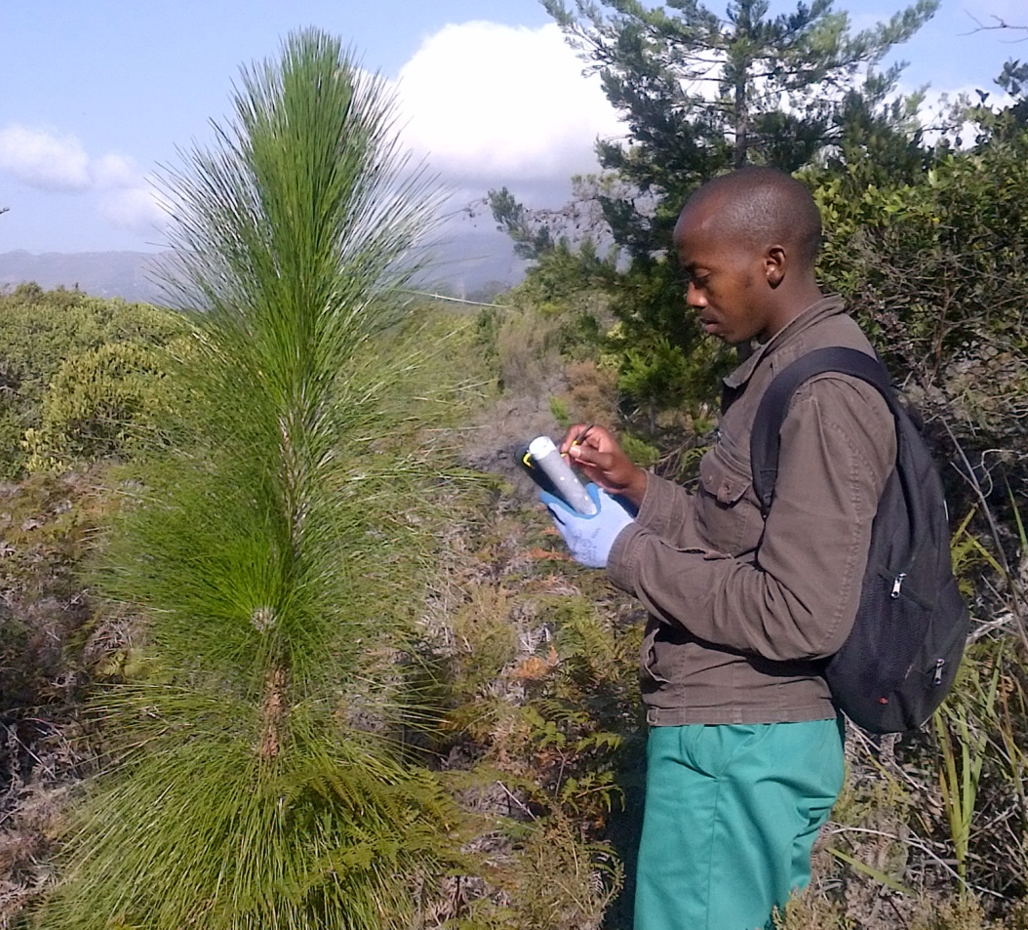
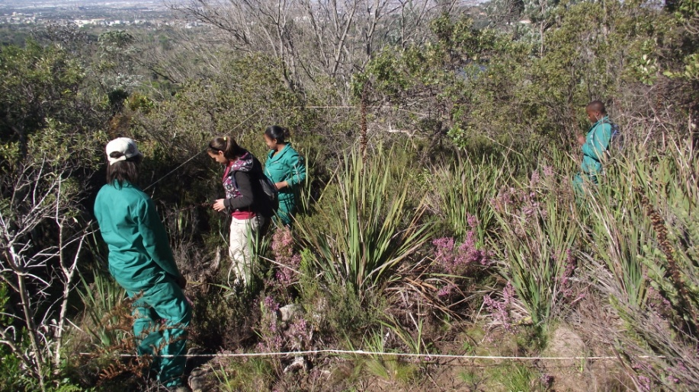
Resource Management
Resource Management
Vegetation Management
Surveys
Bioblitz
Vegetation Surveys (Plots and mapping)

Slide 7
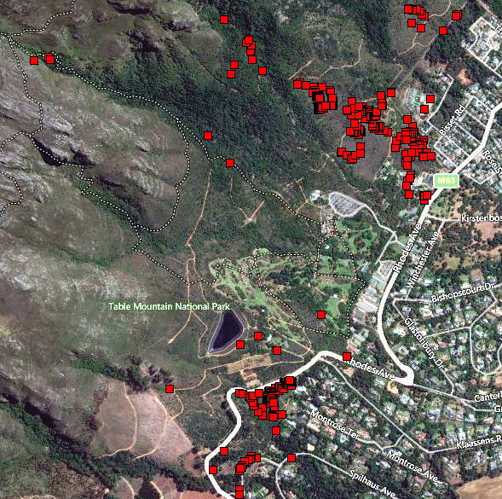
Resource Management Cont..
Surveys cont..
Alien Vegetation Monitoring
Showing the mapped Alien Vegetation

Slide 8
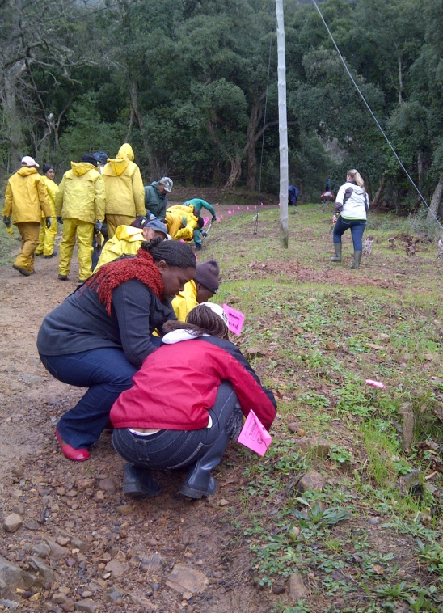
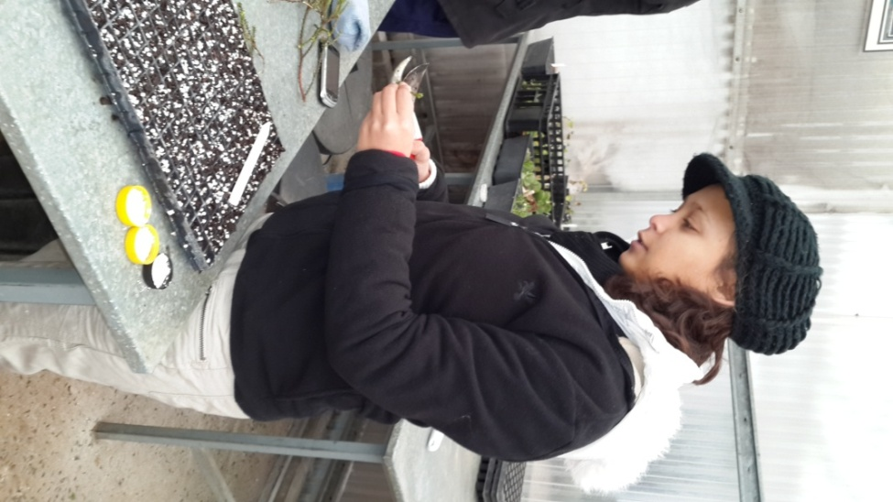
Resource Management Cont..
Veld rehabilitation
Assisting nursery in doing cuttings (Plant propagation).
Silver tree rehabilitation project.

Slide 9
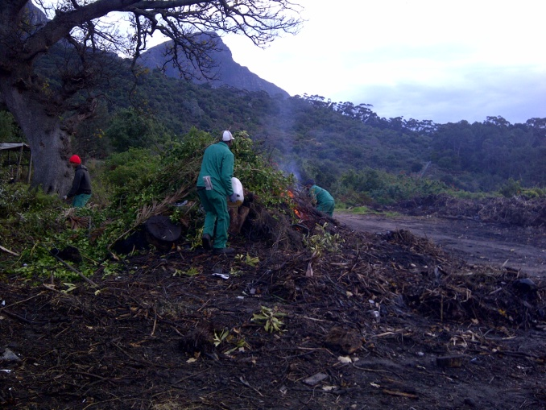
Resource Management Cont..
Fire
Stack burning with Estate Team.

Slide 10
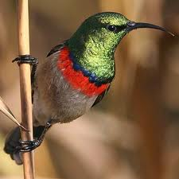
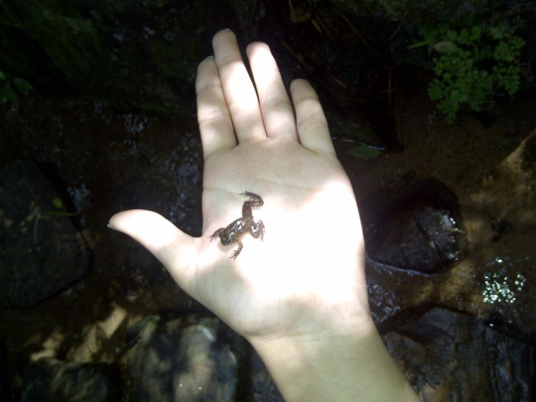
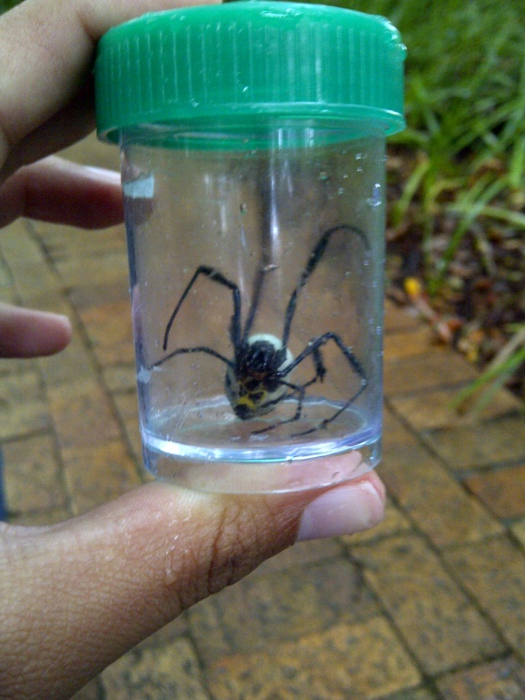
Resource Management Cont..
Wildlife Surveys
Frogging.
Birds Survey
Spider collection.

Slide 11
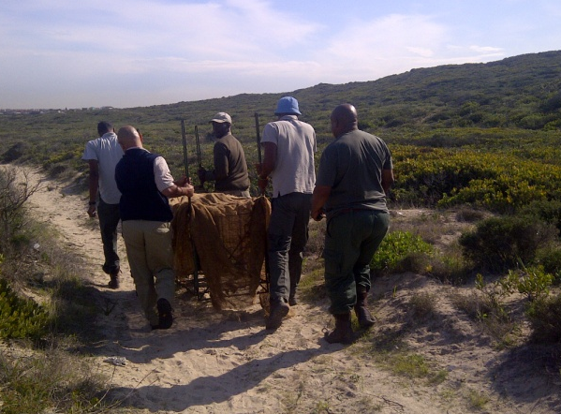
Resource Management Cont..
Wildlife management project
Relocation of porcupine

Slide 12
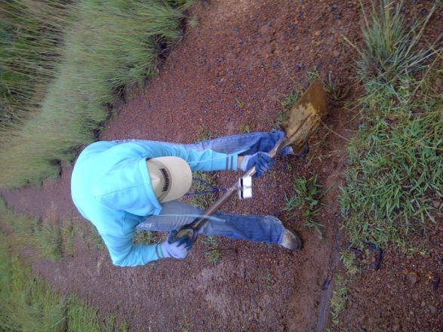
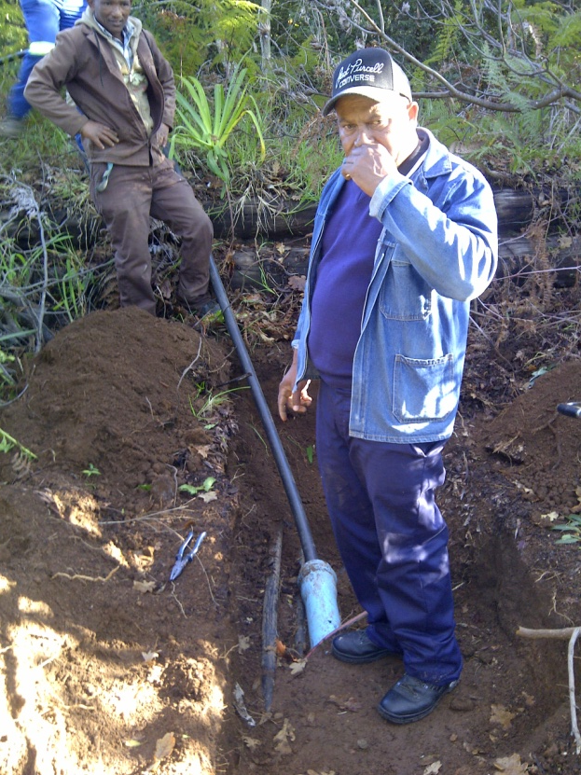
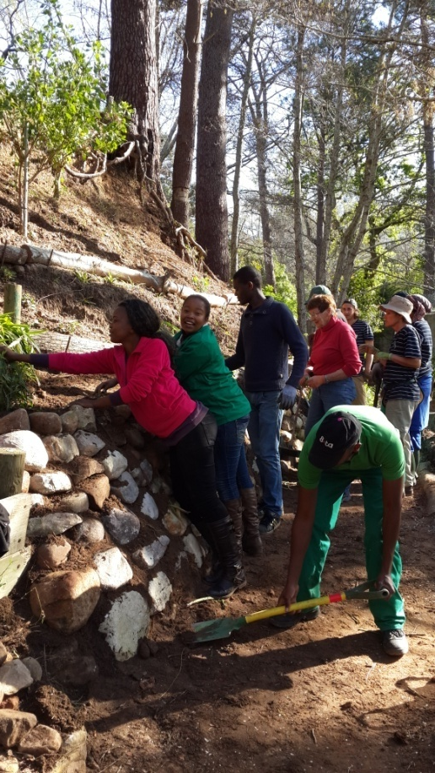
Resource Management Cont..
Soil Management
Water Management
cleaning of water bars, and
building a retaining wall.
assisting the workshop team in plumping.

Slide 13
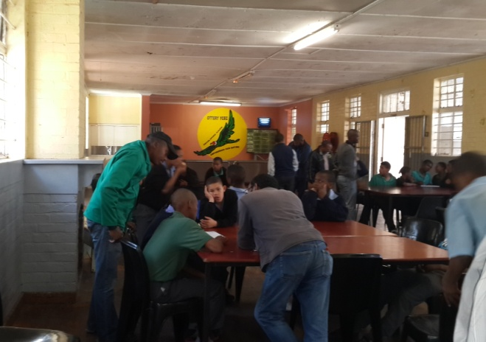
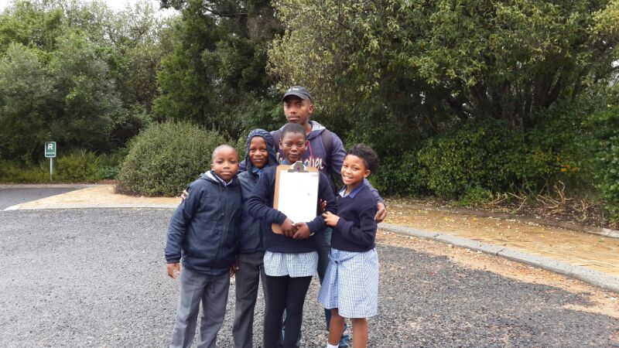
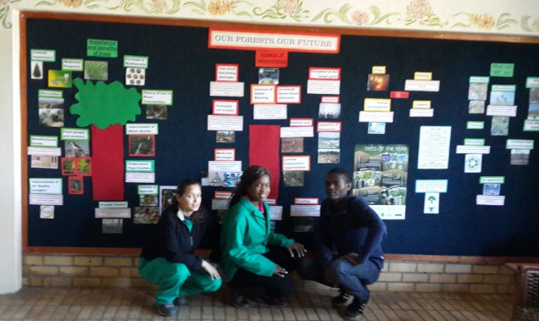
Conservation Communication
Conservation Communication
1. Community Conservation
2. Environmental Education
3. Media and Marketing

Slide 14
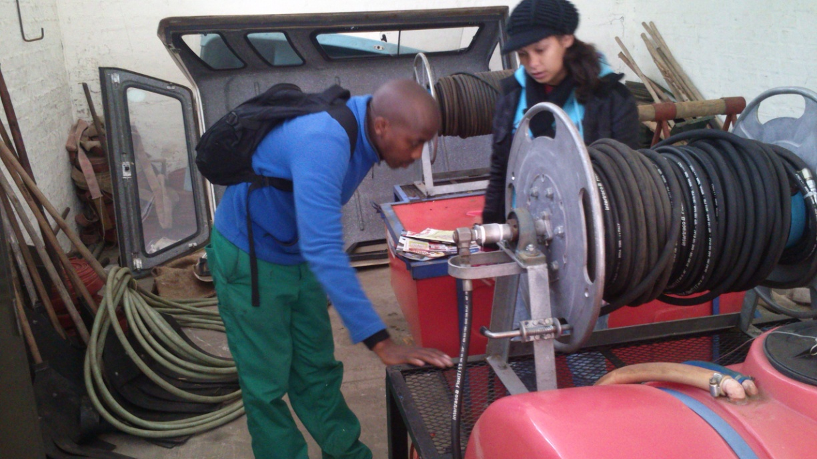
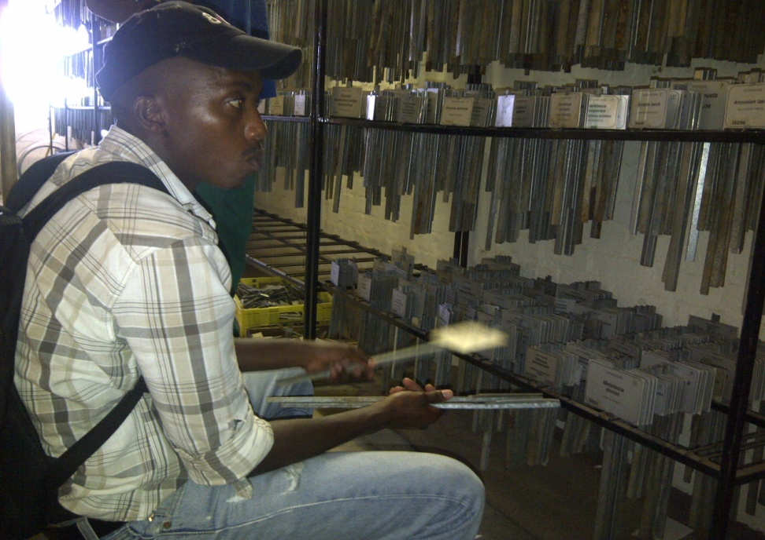
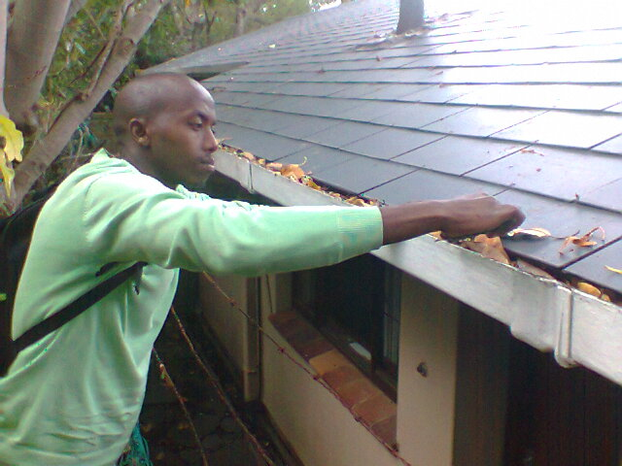
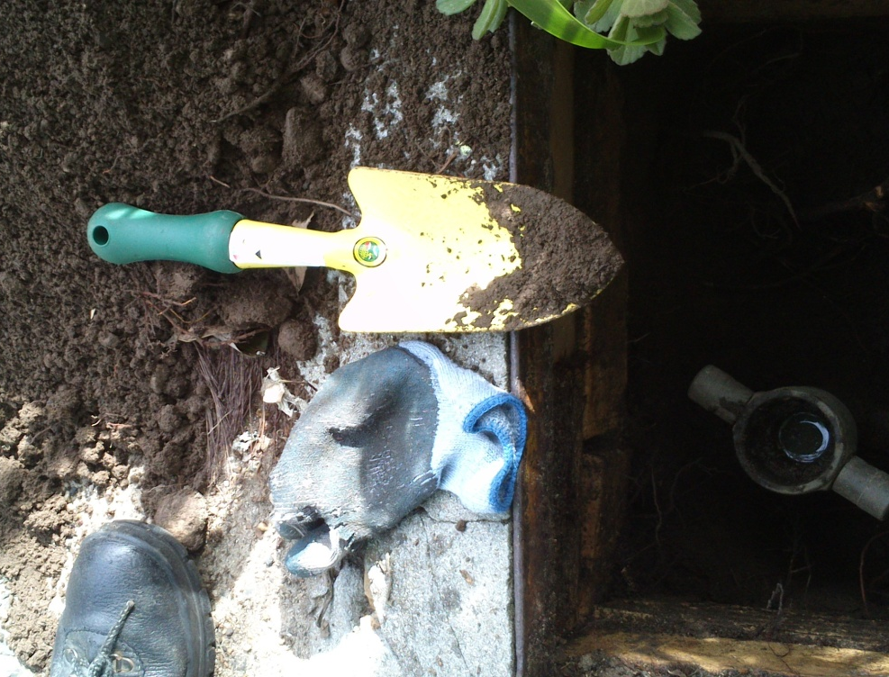
General Administration and Business administration
Business administration
Asset Verification
Maintenance
Labelling
Cleaning gutters
Cleaning Fire Hydrants

Slide 15
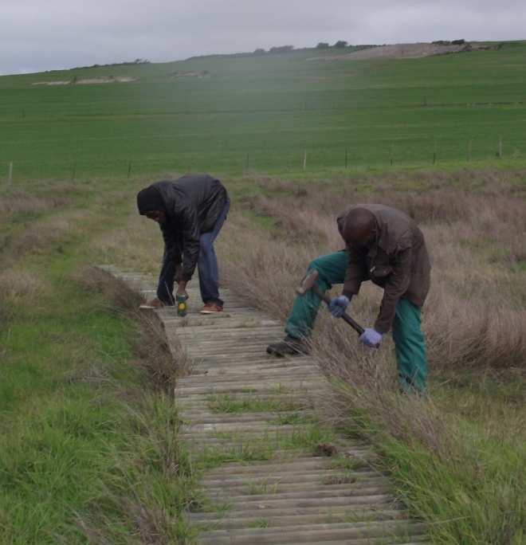
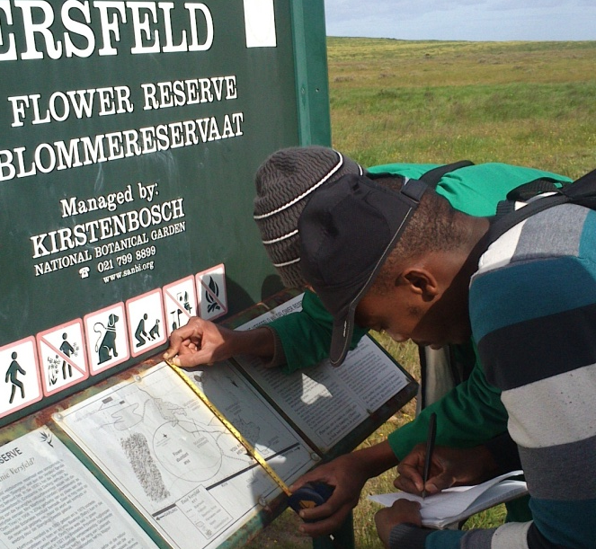
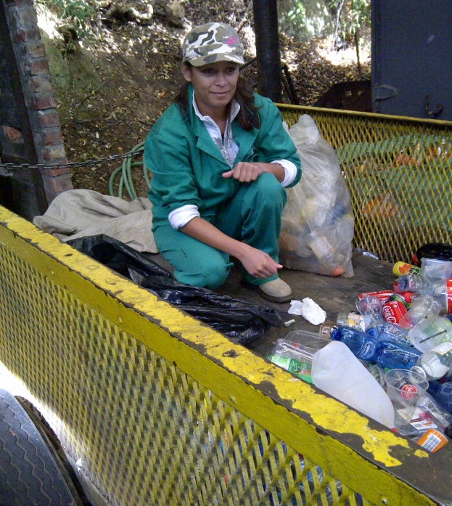
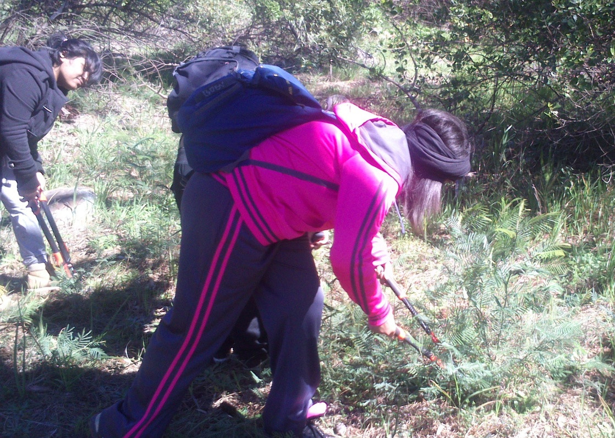
General Administration and Business administration Cont…
Tourist Facilities
Boardwalk maintenance
Litter Management
Signboard maintenance
Human Resource
Supervising Teams

Slide 16
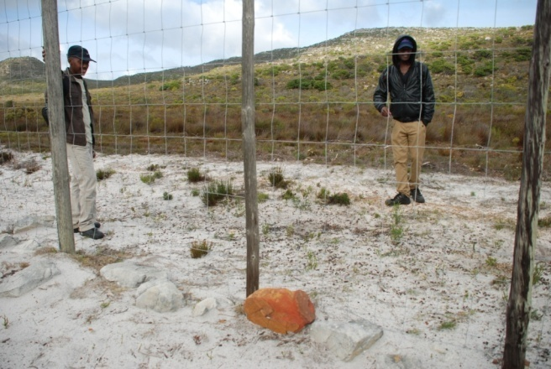
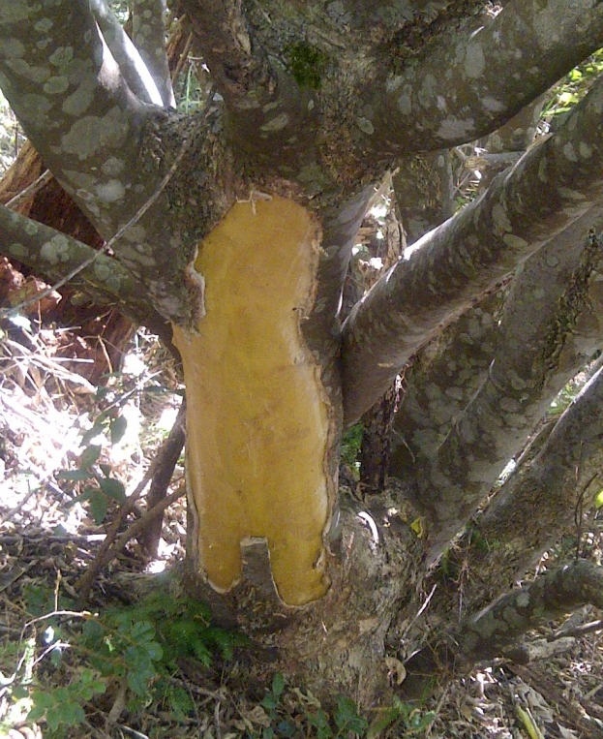
Conservation Compliance
Conservation Compliance
1. Investigation and information gathering
Fence Patrol
Bark stripping occurring at Klaasensbosch.

Slide 17
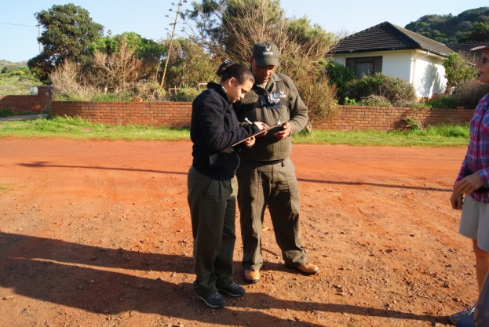
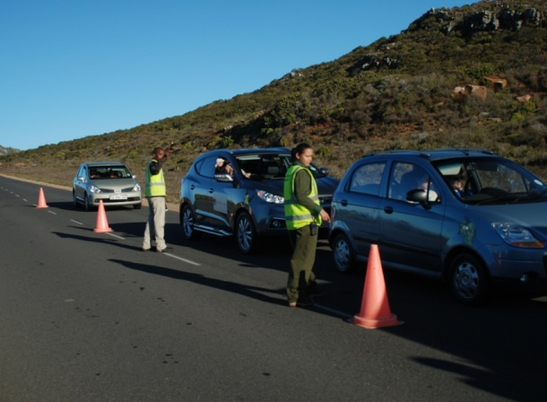
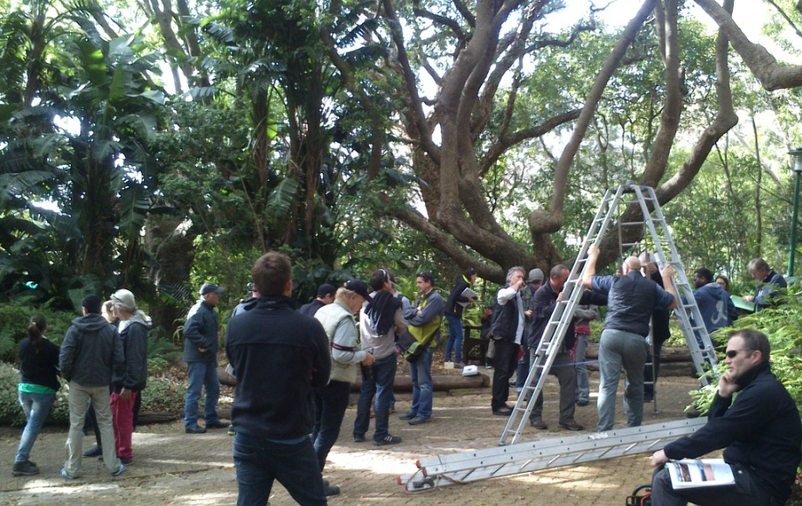
Conservation Compliance Cont..
2. Permit and Compliance
Doing activity permit checks.
Vehicle Check Point
ECOs for filming shoot

Slide 18
Conservation Compliance Cont..
Conservation Compliance Cont…
3. Patrol & Patrol Management
Patrols with
Securities
Record using GPS and pocket book
Patrol with guard dog
Electronic and Hard-copy information stored

Slide 19
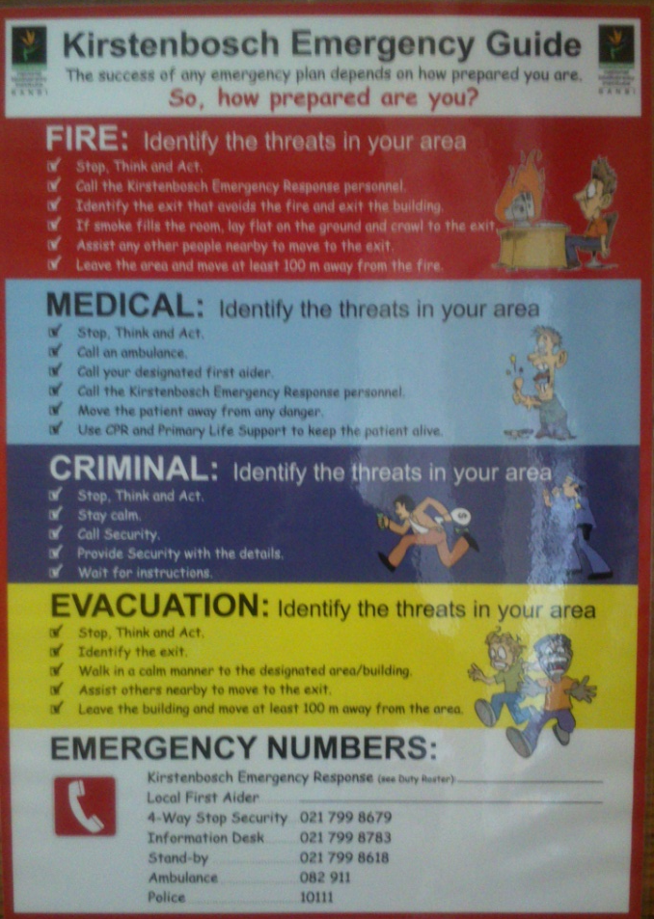
Conservation Compliance Cont..
onservation Compliance Cont…
4.Visitor’s safety, security and risk management
Warning Signs
Emergency evacuation fire drill
Emergency Guide

Slide 20
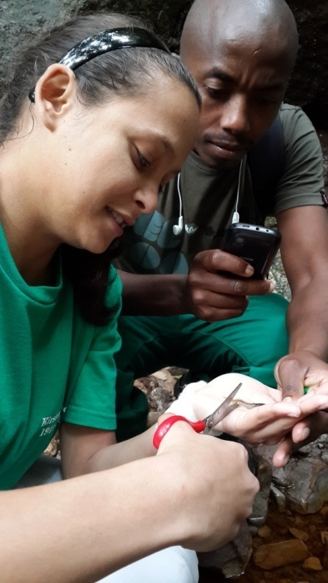
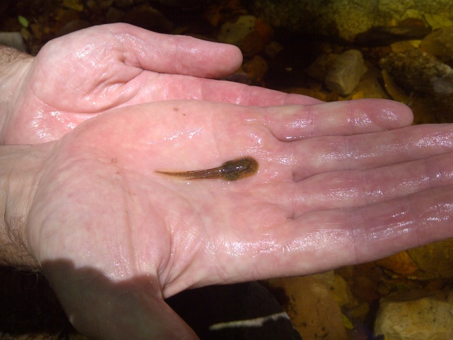
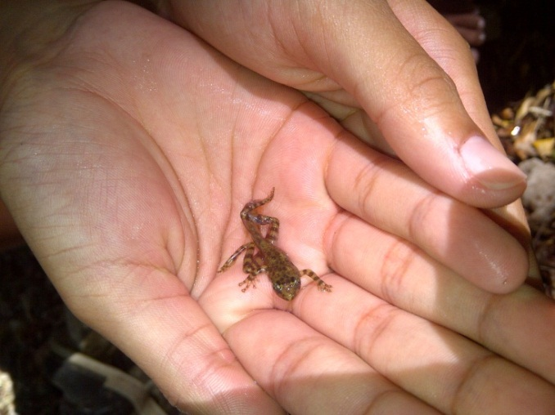
Research Studies
1.Monitoring the status and distribution of the TMGF found at Kirstenbosch
Mark & Recapture
TMGF Tadpole
TMGF Metamorph
2.To evaluate the effectiveness of Alien Vegetation at KNBG
3.To find ways to eradicate all weeds found on lawns

Slide 21
Challenges
Resource Management | General Management | Conservation Communication | Conservation Compliance
Working without PC Bad weather
Catching spiders | Difficulties in finding the asset number | Getting kids in order | Lack of conservation compliance skills
Difficult to track back the location of plots | Shifting heavy furnishers | Simplifying conservation Terms to kids
Working in dense vegetation |  | Display (difficulties in printing)
Picking up heavy big rocks |  | Time

Slide 22
Future Plans
Future Plans and Regular activities | 2014/2015
 | Jan | Feb | Mar | Apr | May | June | July | Aug | Sept | Oct | Nov | Dec
Moles monitoring
Guinea fowl eradication
Silver tree project
Training needed (Courses)
Creature Feature
Western leopard toad (introduction at Bishop’s Court)
Protea Mapping
Penguin Festival
Ghost frog monitoring
Alien vegetation monitoring
Tuff grass monitoring
Management Plans

Slide 23
Conclusion
We are being exposed in the field of our studies (Nature Conservation).
We have acquired many new skills and knowledge.
We have dealt with challenges and conflicts.
We have developed a strong team spirit, while at the same time we can work independently.

Slide 24
Acknowledgements
Groen Sebenza
Elton Le Roux
Estate team
Maintenance team
Construction team
Security
Alien team
Lawn mowers

Slide 25
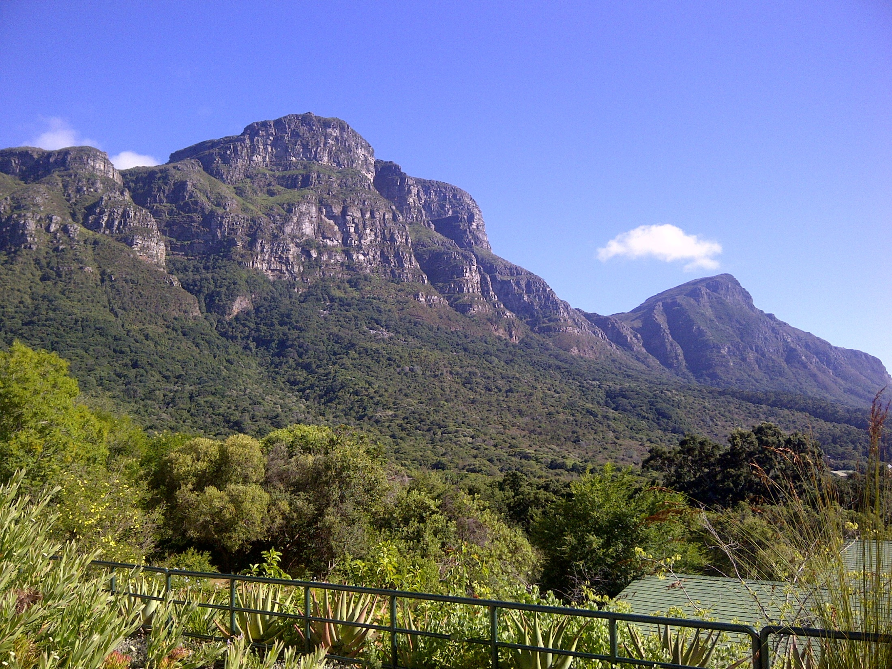
Thank you!

